Slide 1

Prediction of FOREX rates using a Hybrid System
Nathan D’Lima
Under the Guidance of
Prof. Shamsuddin S. Khan
01/10/14
Computer Department,
St. Francis Institute of Technology

Slide 2
CONTENTS
Review of Stage 1
Problem Statement
Literature survey
Proposed work
Summary
References

Slide 3
Review of Stage 1
Currency exchange is the trading of one currency against another.
Home currency – currency to convert
Foreign currency – currency to which home currency is converted
Purchase of goods via the internet where the amount to be paid may be in a foreign currency.
Major uses of Foreign Currency:
  Business trading
  Import and Export of goods
  Private trading
  Banking
  Investments

Slide 4
Review of Stage 1
Foreign currency exchange or FOReign EXchange is called FOREX
It is a global decentralized market for the trading of currencies.
The foreign exchange market determines the relative values of different currencies.
The foreign exchange market is unique because of the following characteristics:
  Its huge trading volume
  Its geographical dispersion;
  Its continuous operation: 24 hours a day except weekends
  The variety of factors that affect exchange rates;
  The low margins of relative profit compared with other markets of fixed income

Slide 5
PROBLEM STATEMENT
The main drawback of current systems is the inability to provide high accuracy rates for future predicted values. A simple neural network gives very low accuracy. The objective is to predict single day and future exchange rates using a Hybrid System with greater accuracy and to predict the rise and fall of the currency rates.

Slide 6
Literature Survey

Slide 7
Forecasting using IT2 FCM and Neural Network ^{[1]}
Uses Interval type 2 Fuzzy c-means clustering, MLP neural network and interval type 2 fuzzy model
Back Resilient Algorithm is used to train NN quicker
Closing price, simple moving average (%K) and exponential moving average (%D) given as inputs
Membership values are type 2 fuzzy sets, they are defined by Gaussian functions
Defuzzification is used to obtain crisp output
Data obtained from 1st April 2005 to 10th Dec 2012.
MSE is used to compare results

Slide 8
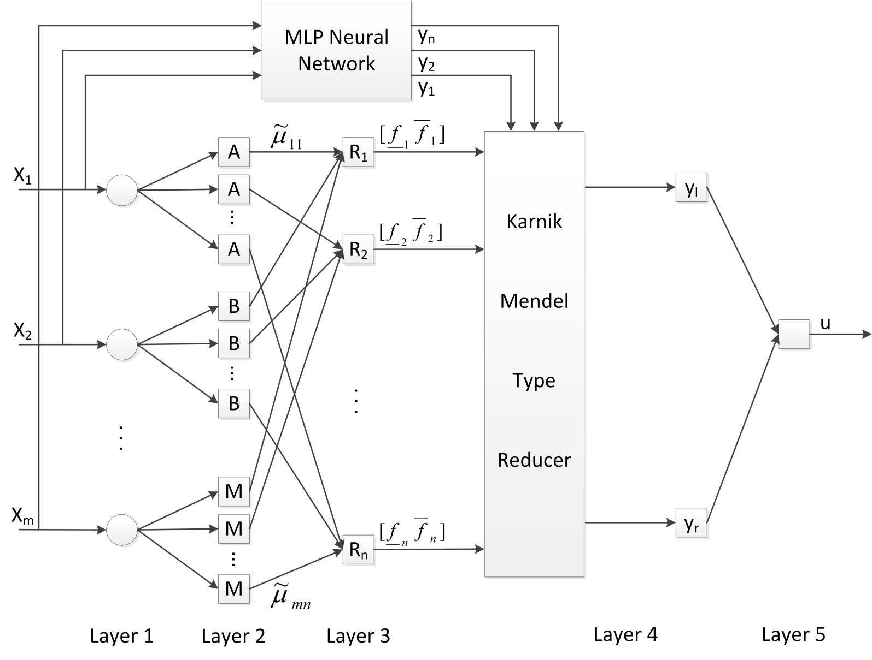
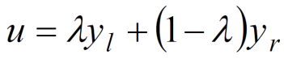
IT2 FCM based neuro-fuzzy model
Input
Fuzzification
Firing strength of each rule
Finding Consequent
Defuzzification and output
Figure: Neuro Fuzzy model using IT2 FCM and MLP neural network

Slide 9
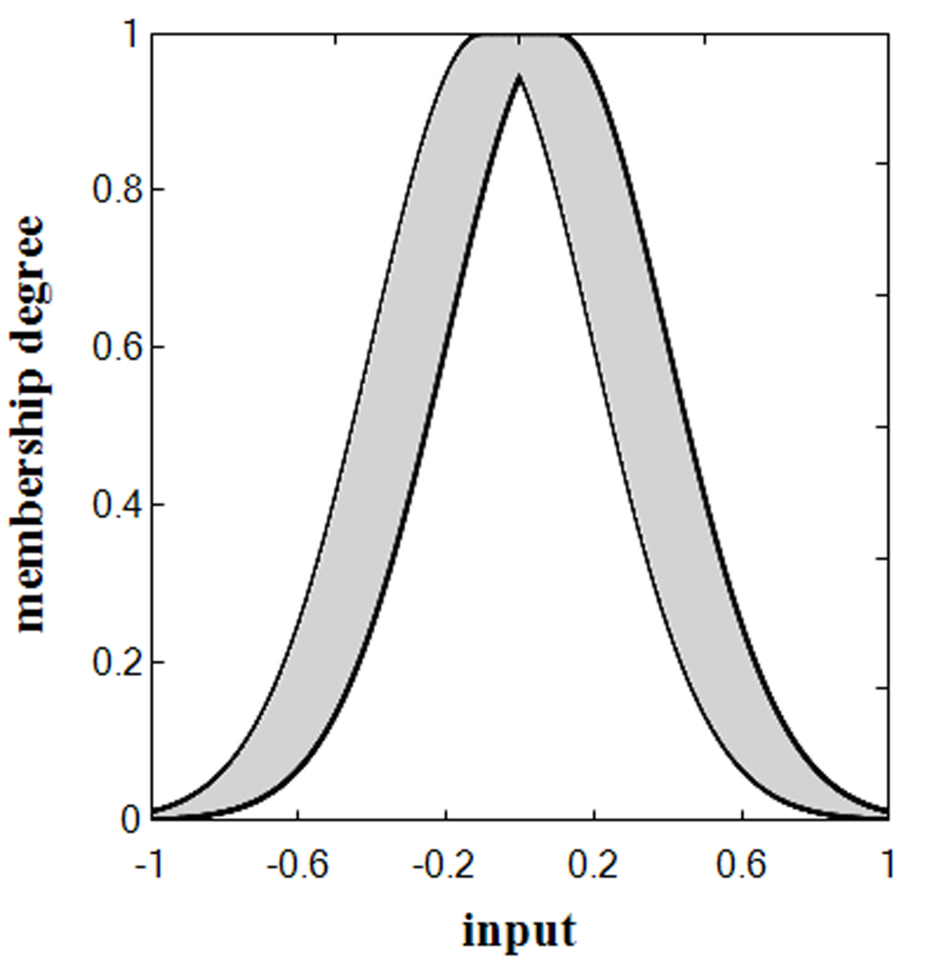
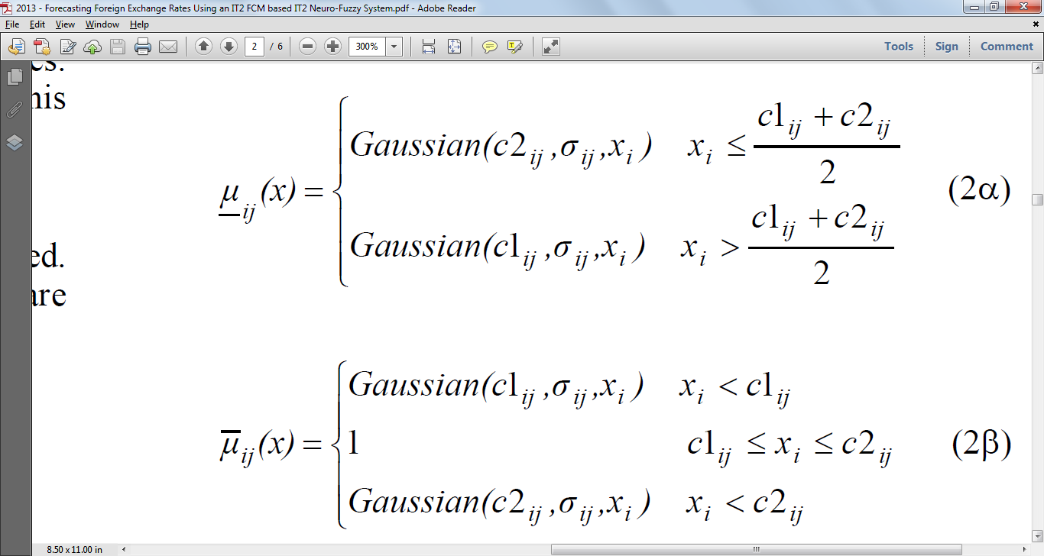
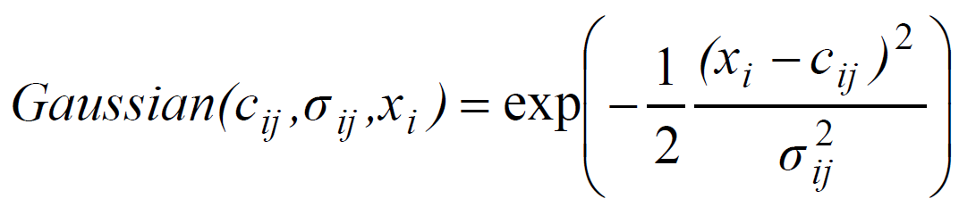
Interval Type-2 Gaussian function
Figure: IT2 Gaussian Membership Function

Slide 10
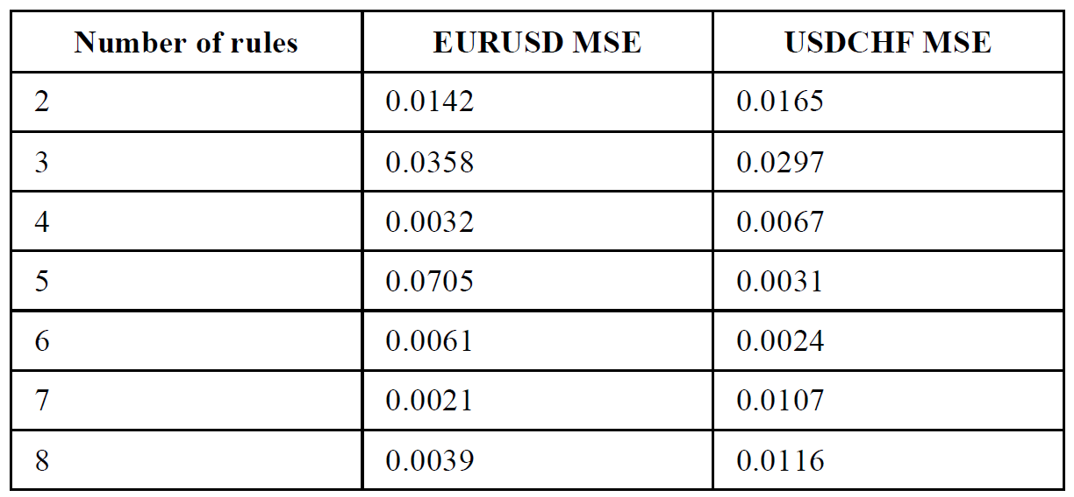
Rules
The MLP part of neuro-fuzzy system is made with one hidden layer contains 20 neurons
50 epochs are used for training
Layer 3 calculates firing strength of antecedents, layer 4 calculates the strength of consequent based on rules.

Slide 11
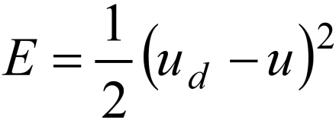
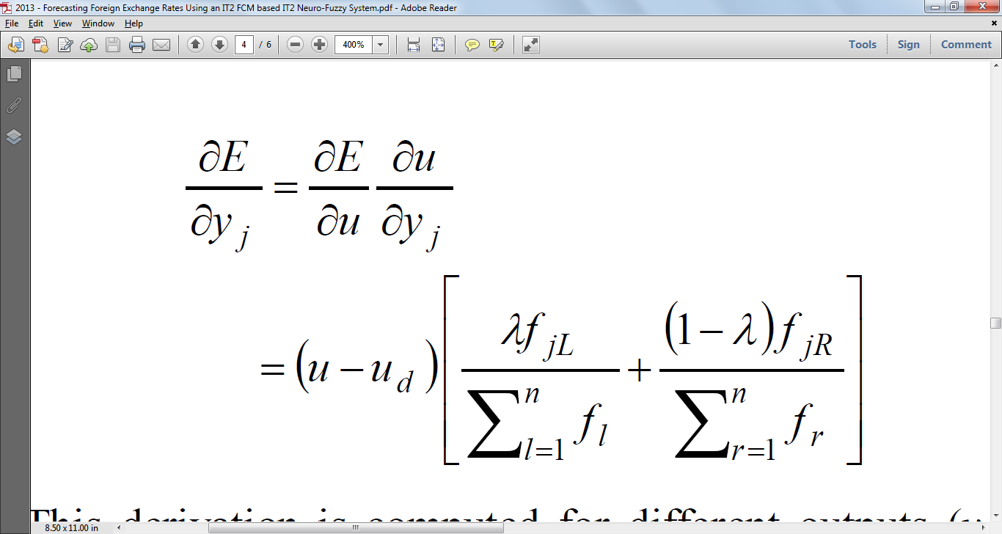
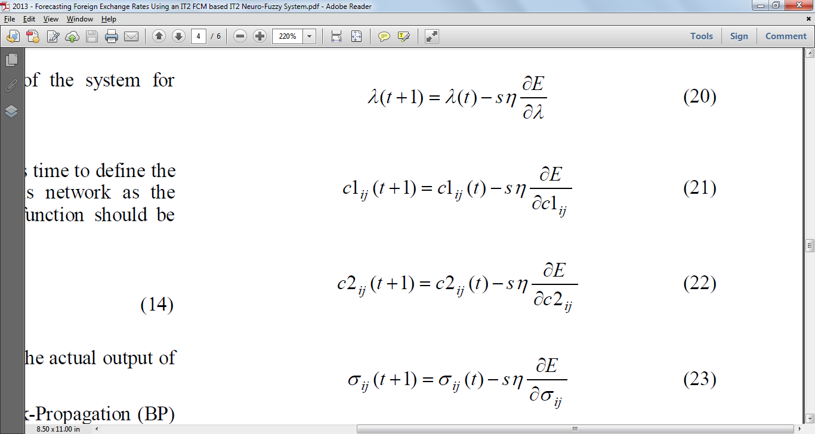
Optimizing Parameters
Error is given by –
Gradient of error is used in Back-resilient algorithm which is used to train the NN quicker
Parameter Updates are given by –

Slide 12
Neural Network Based Stock Trading Strategy ^{[2]}
MLP neural network used to determine optimal buy and sell time
3 learning algorithms: standard back propagation with momentum, modified back propagation, and variable step search algorithm
The training set comprised the data from 1st Jan 1995 to 31st Dec 2004 and testing set comprised the data from 1st Jan 2005 to 1st Jan 2008.
Provides optimal buy and sell moments at stock exchange using a neural network based prediction.

Slide 13
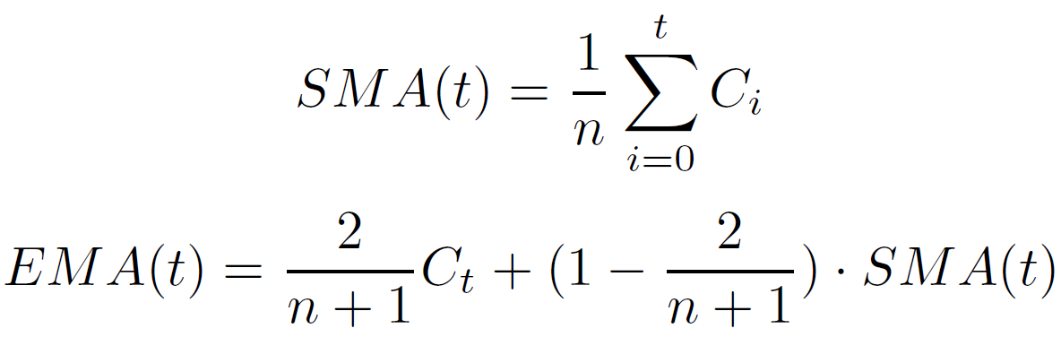
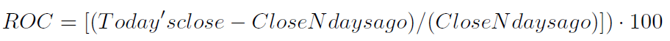
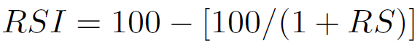
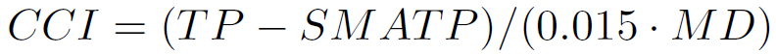
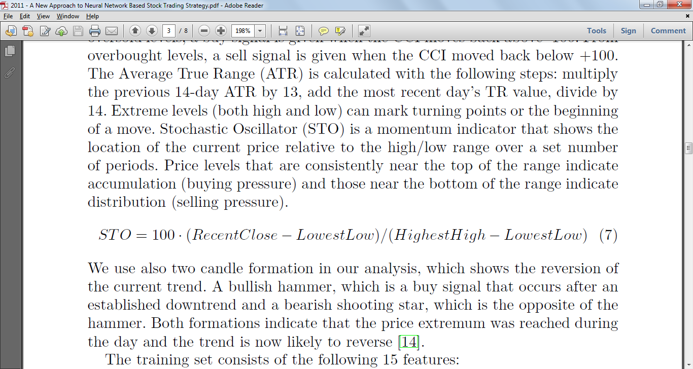
Input Variables
Input Parameters | Time period (in days)
Price range | 1 | 2 | 3
Simple Moving Average (SMA) | 6 | 9 | 14 | 21
Rate of Change (ROC) | 6 | 9 | 14 | 21
Relative Strength Index (RSI) | 6 | 9 | 14 | 21
Commodity Channel Index (CCI) | 6 | 9 | 14 | 21
Stochastic Oscillator (STO) | 6 | 9 | 14 | 21
Average True Rate (ATR) | 6 | 9 | 14 | 21

Slide 14
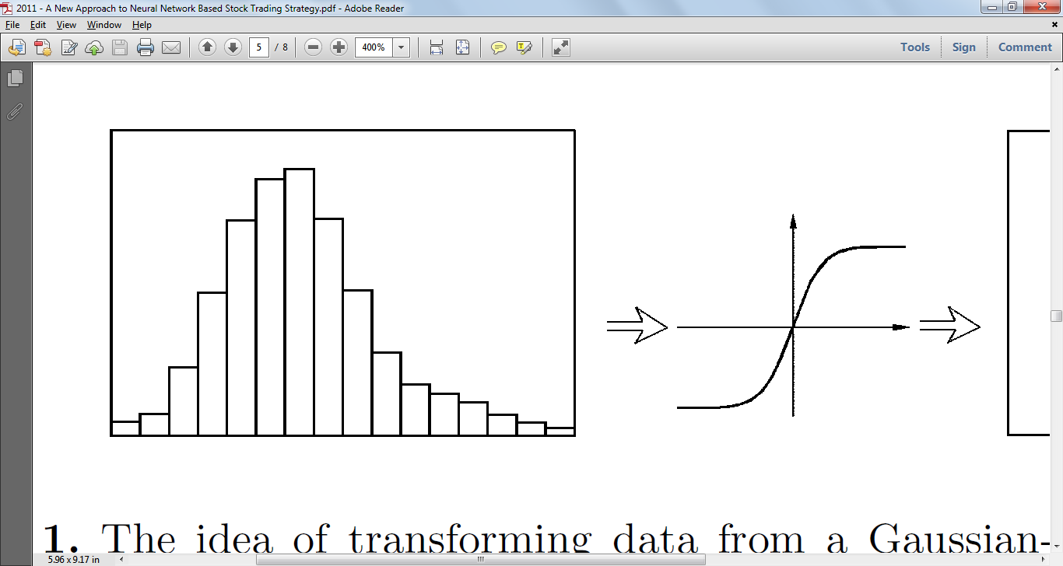
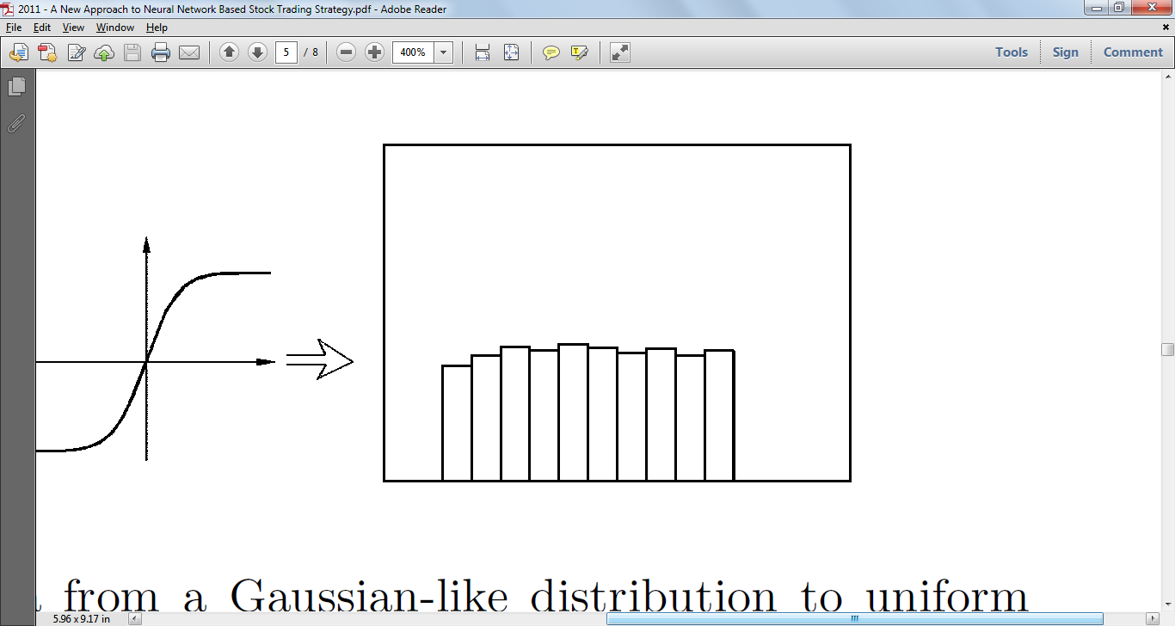
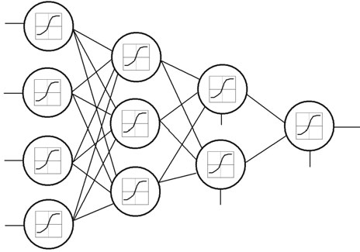
NN Architecture
Figure: Transformation of data from Gaussian to uniform distribution
Figure: Neural Network Architecture

Slide 15
Optimal Exchange Rate Forecasting ^{[3]}
Data of daily exchange rates in the United Kingdom, European Union, and Swiss Franc between the dates 3rd Jan 2012 and 1st March 2013.
  3 methods for forecasting :
    Neural networks (NN)
    Vector singular spectrum analysis (VSSA)
    Recurrent singular spectrum analysis (RSSA)
Root Mean Square Error (RMSE) & Direction Change (DC) used for evaluating accuracy
RSSA and VSSA give ~60% accuracy while NN gives ~48% accuracy

Slide 16
Prediction of forex rates by NN and fuzzy system techniques ^{[5]}
Predicts FOREX rate for USD to GBP
Datasets comprises 1000 daily rates from the end of 1997 to the end of March 2000.
Uses 5 different methods
  MLP with standard BP
    Uses 5 inputs and 2 hidden layers
  RBF with Orthogonal Least Squares (OLS) for training
    Past 5 values used as input
  ARNN
    2 hidden layers and single linear output node
    Allows reccurrence only in 1st hidden layer
  Elman Network
    4 input nodes, 2 hidden layers with 16 and 24 nodes, 1 output node
    Self feedback applied on layer with 16 nodes
  AFLS
    Uses Balance of Area (BOA) for defuzzification
    Has multiple inputs and multiple outputs

Slide 17
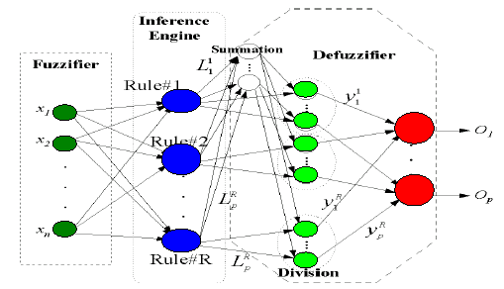
AFLS Architecture
Figure: Adaptive Fuzzy Logic System Architecture

Slide 18
Improve the Prediction of Exchange Rate Time Series with ARIMA ^{[6]}
Financial series have high non-linearity, noise and complexity
Simple linear ARIMA (Auto Regressive Integrated Moving Average) cannot be used to model financial data
To solve non-linearity problem of FOREX rate time series, MLP and RBF used along with ARIMA
Proposed model detects error and models it using MLP
Remainder error is modelled using RBF to reduce final error
There are 3440 daily exchange rate data in the dataset from 1 April 2001 to 31 July 2010. The days without data were padded with the average exchange rate value of the last three days.
For the neural network learning purpose up to 7 days before data was used to predict the next day.

Slide 19
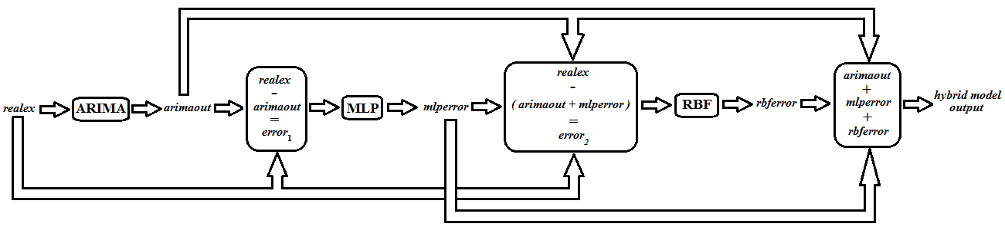
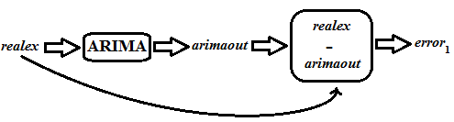

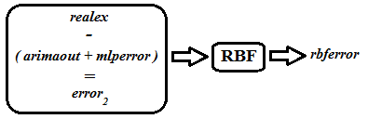
Hybrid Model
Hybrid Block
Second Block
First Block
Third Block
Hybrid Model

Slide 20
Performance comparison
Data set | Model | RMSE
EUR – USD | FLIT2FNS ^{[1]} | 0.00613
 | IT2FCMFNS ^{[1]} | 0.00165
 | T1FCMFNS ^{[1]} | 0.00172
 | Single RBF ^{[6]} | 0.0085
 | Single MLP ^{[6]} | 0.0076
 | Single ARIMA ^{[6]} | 0.0081
 | Hybrid (ARIMA+MLP+RBF) ^{[6]} | 0.0068
USD – GBP | BP ^{[5]} | 0.421
 | RBF ^{[5]} | 0.3995
 | ARNN ^{[5]} | 0.4021
 | ELM ^{[5]} | 0.4010
 | AFLS ^{[5]} | 0.3939

Slide 21
PROPOSED WORK
Propose a new technique which uses a Multi Layer Perceptron Neural Network and with back propagation and a Hybrid System.
Apply methods used in stock market prediction to predict rise and fall of FOREX rates.
A MLP neural network with back propagation algorithm to determine rise and fall of exchange rates.
A hybrid system using ANFIS to predict future values and provide higher accuracy than most other neural networks.

Slide 22
PROPOSED ARCHITECTURE
SMA
Rise / Fall of FOREX market
ROC
STO
Predicted Output
ATR
Update Weights
Error
─
Actual Output
Figure: MLP Network with Back Propagation

Slide 23




PROPOSED ARCHITECTURE
A₁
Closing Rate
W₁
π
N
f₁
A₂
Predicted FOREX rate
Σ
B₁
Moving Average
π
N
f₂
W₂
B₂
Input Layer
Layer 1
Fuzzfication
Layer 2
Firing strength
Layer 3
Normalization
Layer 4
Finding consequent
Layer 5
Defuzzification and Output
Figure: ANFIS architecture

Slide 24
Summary
Forex prediction minimizes risks and maximized profits.
Prediction allows traders to use various strategies and trade various currencies to obtain maximum profit.
Hybrid Systems perform better than individual systems like NN, ARNN, RBF, etc.
Combination of MLP (to check rise and fall of market) and Hybrid System (to predict the rate) provides a more robust system.

Slide 25
REFERENCES
[1] Emad F, M.A. Montazeri, “ Forecasting Foreign Exchange Rates Using an IT2 FCM based IT2 Neuro-Fuzzy System” in 21st Iranian Conference on Electrical Engineering (ICEE), 2013.
[2] A. Cwiok, M. Kordos, “A New Approach to Neural Network Based Stock Trading Strategy”, in Intelligent Data Engineering and Automated Learning - IDEAL 2011Lecture Notes in Computer Science Volume 6936, 2011, pp 429-436.
[3] B. Christina, Y. Masoud, “FORECASTING EXCHANGE RATES: AN OPTIMAL APPROACH” in J Syst Sci Complex (2014) 27: 21–28.
[4] http://fxtrade.oanda.com/learn/technical-analysis-for-traders/ stochastic/summary

Slide 26
REFERENCES
[5] V. Kodogiannis and A. Lolis, "Prediction of foreign exchange rates by neural network and fuzzy system based techniques," in European Symposium on Artificial Neural Networks Bruges (Belgium), April 2001, pp. 245-250
[6] A.N. Kia, M. Fathian and M.R. Gholamian, “Using MLP and RBF Neural Networks to Improve the Prediction of Exchange Rate Time Series with ARIMA”, International Journal of Information and Electronics Engineering, Vol. 2, No. 4, 2012, pp. 543-546

Slide 27
QUESTIONS?

Slide 28
THANK YOU!

